Slide 1

AWS Overview
Sameer Zulfi

Slide 2

3 Major Cloud Platforms

Slide 3
Free Tier – AWS
URL - Free Cloud Computing Services - AWS Free Tier (amazon.com)
Free Trials
12 months Free
Always Free
The AWS Free Tier is not available in the AWS GovCloud (US) Regions* or the China (Beijing) region at this time.
The AWS Free Tier is available to all types of customers – students, entrepreneurs, small businesses, and Fortune 500 companies are all welcome to sign up.

Slide 4
AWS Free Tier – FAQ
AWS Free Tier is applied to your monthly usage. It will expire on the 1st day of each month, and does not accumulate
If your usage exceeds the monthly free tier limits, you simply pay standard, pay-as-you-go AWS service rates. See the AWS Pricing page for full pricing details.
The AWS Free Tier applies to participating services across our global regions. Your free usage under the AWS Free Tier is calculated each month across all regions and automatically applied to your bill. For example, you will receive 750 Amazon EC2 Linux Micro Instance hours for free across all of the regions you use, not 750 hours per region. Unused monthly usage will not roll over to future months. The AWS Free Tier is now available in China (ZHY) region as well. The AWS Free Tier is not available in the China (BJS) region or AWS GovCloud (US) regions, with the exception of Lambda for AWS GovCloud (US).
AWS Free Tier includes 750 hours of Linux and Windows t2.micro instances, ( t3.micro for the regions in which t2.micro is unavailable) each month for one year. To stay within the Free Tier, use only EC2 Micro instances.

Slide 5
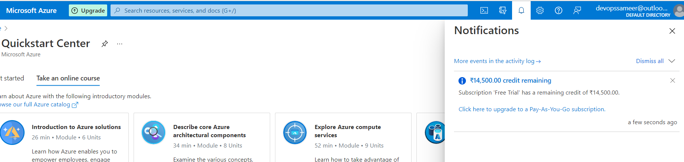
Azure Free Tier
URL - Create Your Azure Free Account Today | Microsoft Azure
Popular services free for 12 months
25+ other services free always
Start with USD200* Azure credit

Slide 6
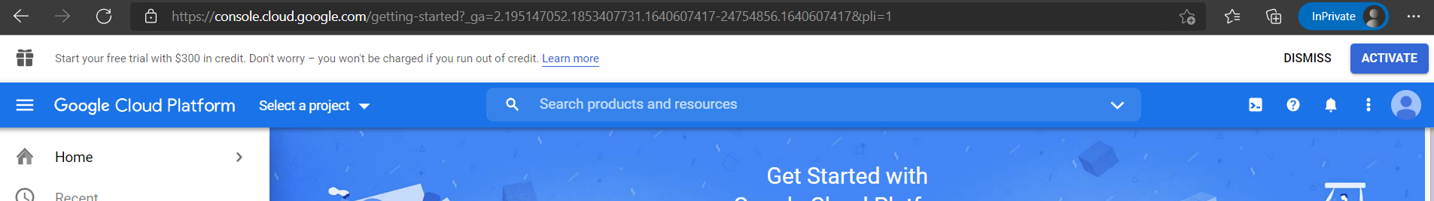
GCP Free Tier
Free Trial and Free Tier | Google Cloud
Google Cloud Free Program
20+ free products
$300 in free credits

Slide 7
List of Product Categories in AWS
Analytics
Application Integration
Business Productivity
Compute
Containers
Customer Engagement
Database
Developer Tools
End User Computing
Front-End Web & Mobile
Game Tech
Internet of Things
Machine Learning
Management & Governance
Media Services
Migration & Transfer
Networking & Content Delivery
Robotics
Security, Identity & Compliance
Serverless
Storage

Slide 8
Analytics
Amazon OpenSearch Service (successor to Amazon Elasticsearch Service)
Amazon QuickSight
Amazon Redshift
AWS Data Pipeline
AWS Glue
Athena
CloudSearch
AWS Data Exchange
Data Pipeline
EMR
Amazon FinSpace
AWS Glue DataBrew
Kinesis
AWS Lake Formation
MSK

Slide 9
Application Integration
Amazon MQ
Amazon SQS
Amazon SWF
AWS Step Functions
Amazon Honeycode
AWS AppSync
AppFlow
EventBridge
Managed Apache Airflow
SNS

Slide 10
AR & VR
Sumerian

Slide 11
AWS Cost Management
AWS Application cost Profiler
AWS Budgets
AWS Cost Explorer
AWS Marketplace Subscriptions

Slide 12
BlockChain
Amazon Managed BlockChain

Slide 13
Business Applications
Amazon Chime
Amazon WorkDocs
Amazon Honeycode
Alexa for Business
Amazon Connect
Amazon Pinpoint
Amazon Simple Email Service
Amazon WorkMail

Slide 14
Compute
AWS App Runner
Batch
EC2
EC2 Image Builder
Elastic BeanStalk
Lambda
Lightsail
AWS Outposts
Serverless Application Discovery

Slide 15
Containers
Red Hat OpenShift Service on AWS
AWS EKS
Amazon Elastic Container Registry
Amazon ECS

Slide 16
Customer Enablement
Activate for Startups
AWS IQ
Managed Services
Support

Slide 17
Database
Cloud9
CloudShell
CodeArtifact
CodeBuild
CodeCommit
CodeDeploy
CodePipeline
CodeStar
AWS FIS
X-Ray

Slide 18
Developer Tools
Amazon CloudWatch
AWS CodeBuild
AWS CodeCommit
AWS CodePipeline
AWS X-Ray
AWS CodeArtifact

Slide 19
End User Computing
Amazon AppStream 2.0
Amazon WorkLink
WorkSpaces

Slide 20
Front-End Web & Mobile
AWS Amplify
AWS AppSync
Device Farm
Amazon Location Service

Slide 21
Game Development
Amazon GameLift

Slide 22
Internet of Things
FreeRTOS
IoT 1-click
IoT Analytics
IoT Core
IoT Device Defender
IoT Device Management
IoT Events
AWS IoT FleetWise
IoT Greengrass
IoT RoboRunner
IoT SiteWise
IoT things Graph
IoT TwinMaker

Slide 23
Machine Learning
Augmented AI
CodeGuru
Comprehend
DeepComposer
DeepLens
DeepRacer
DevOps Guru
Forecast
Fraud Detector
HealthLake
Kendra
Lex
Lookout for Equipment
Lookout for Metrics
Monitron
Panorama
Personalize
Polly
Rekognition
SageMaker
Textract
Transcribe
Translate

Slide 24
Management & Governance
AWS AppConfig
Auto Scaling
Chatbot
CloudFormation
CloudTrail
CloudWatch
Compute Optimizer
Config
Control Tower
Amazon Grafana
Incident Manager
Launch Wizard
License Manager
Opsworks
AWS Organizations
Personal Health Dashboard
Prometheus
Proton
Resilience Hub
Resource Groups & Tag Editor
Service Catalog
Systems Manager
Trusted Advisor
AWS Well-Architected Tool

Slide 25
Media Services
Amazon Elastic Transcoder
Elemental Appliances & Software
Amazon Interactive Video Service
Kinesis Video Streams
MediaConnect
MediaCovert
MediaLive
MediaPackage
MediaStore
MediaTailor
Nimble Studio

Slide 26
Migration & Transfer
Application Discovery Service
Application Migration Service
Database Migration Service
DataSync
Mainframe Modernization
Migration Hub
Server Migration Service
SnowFamily
Transfer Family

Slide 27
Networking & Content Delivery
Amazon API Gateway
Amazon CloudFront
App Mesh
Cloud Map
Direct Connect
Global Accelerator
Route 53
VPC
VPC IP Address Manager

Slide 28
Quantum Technologies
Amazon Braket

Slide 29
Robotics
AWS RoboMaker

Slide 30
Satellite
Ground Station

Slide 31
Security, identity & Compliance
Artifact
Audit Manager
Certificate Manager
CloudHSM
Cognito
Detective
Directory Service
Firewall Manager
GuardDuty
IAM
Inspector
Key Management Service
Macie
Network Firewall
Resource Access Manager
Secrets Manager
Security Hub
Signer
Single Sign-On
WAF & Sheild

Slide 32
Serverless
Amazon S3
Amazon DynamoDB
AWS Lambda
Amazon SNS
Amazon API Gateway
Amazon SQS
AWS Step Functions
AWS AppSync

Slide 33
Storage
Amazon S3
Amazon CloudFront
Amazon EFS
Amazon Elastic Block Storage
AWS Storage Gateway
Amazon ECS Anywhere
AWS Backup
Elastic Disaster Recovery
FSx
S3 Glacier

Slide 34
>170 Services in Total in AWS

Slide 35
Why moving to AWS/ any cloud?
Flexibility
Cost-Effective
Scalable and Elastic
Secure
Experienced

Slide 36
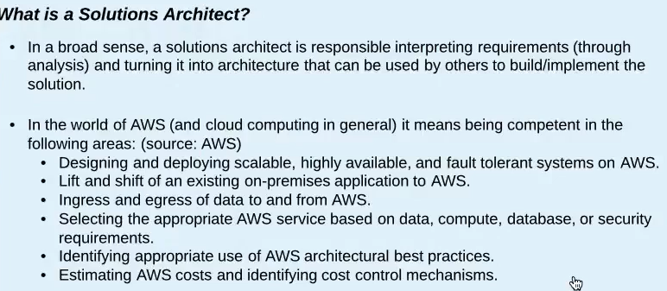
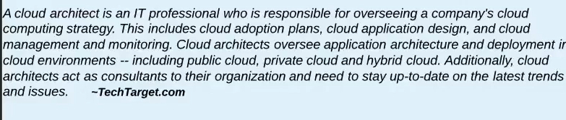
Who is a AWS Solution Architect ?

Slide 37
AWS Certifications
Explore all AWS Certification exams | Validate AWS Cloud Skiills (amazon.com)
Exam Guide - AWS-Certified-Solutions-Architect-Associate_Exam-Guide.pdf (awsstatic.com)

Slide 38
Few Terminologies
Region
Edge Locations
Availability Zones
High Availability
Fault Tolerant
Scalability
Elasticity
Instance
Cost Efficient
Secure

Slide 39
Setting up an AWS Account

Slide 40
How to read the bill and Cost budget creation

Slide 41
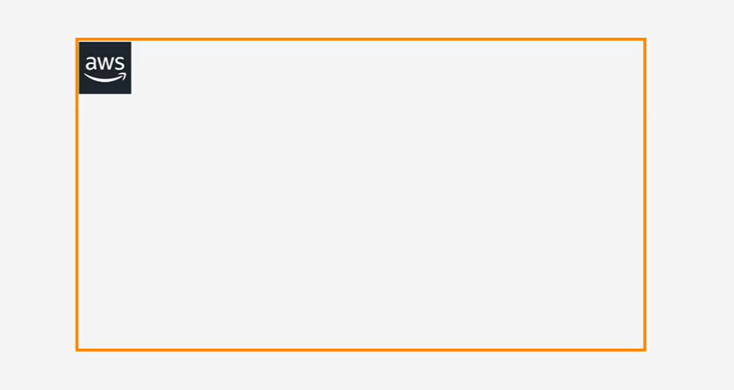
AWS Accounts Walkthrough

Slide 42
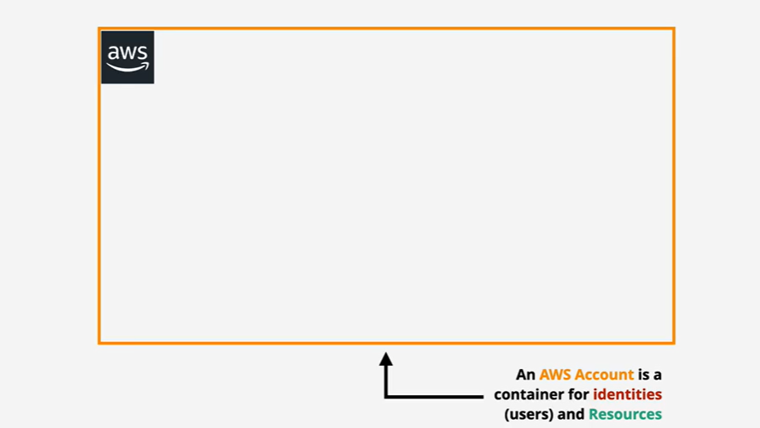

Slide 43
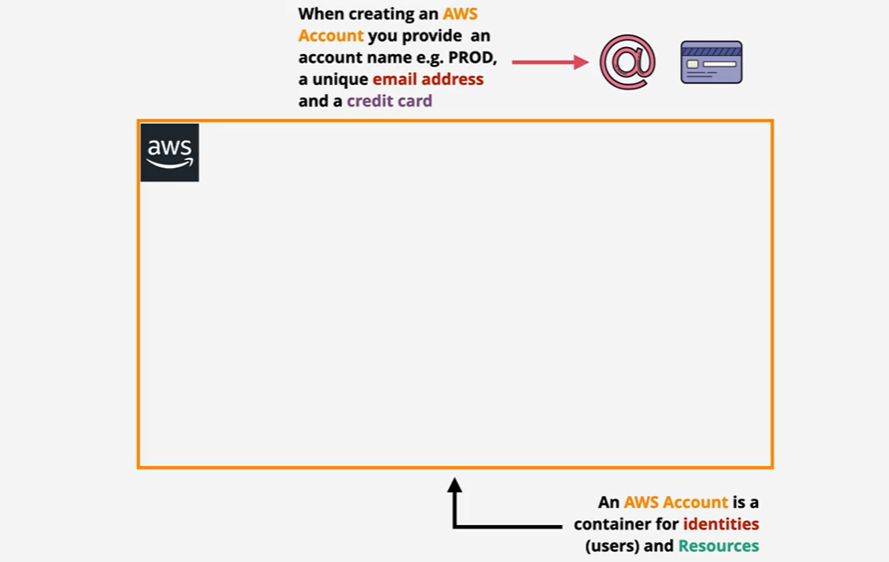

Slide 44
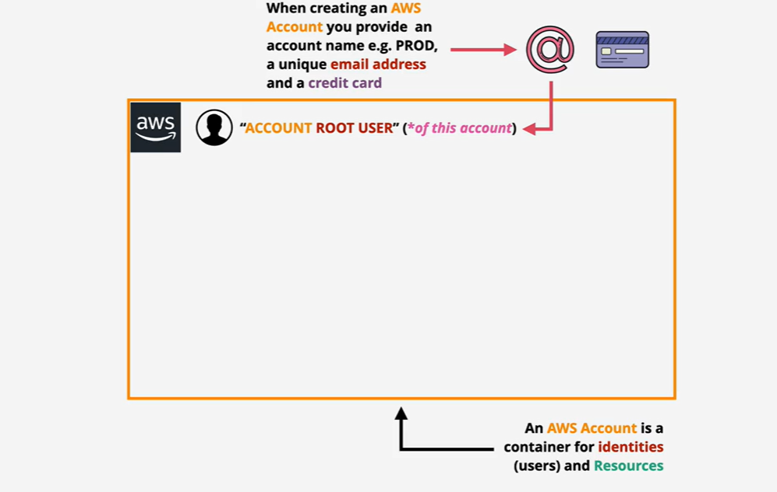

Slide 45
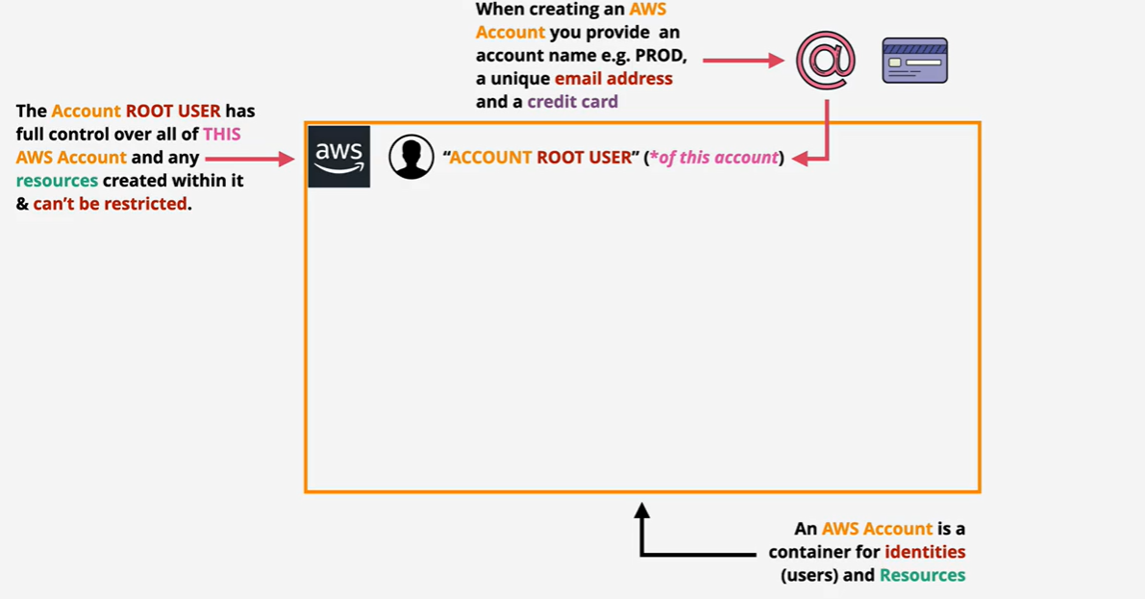

Slide 46
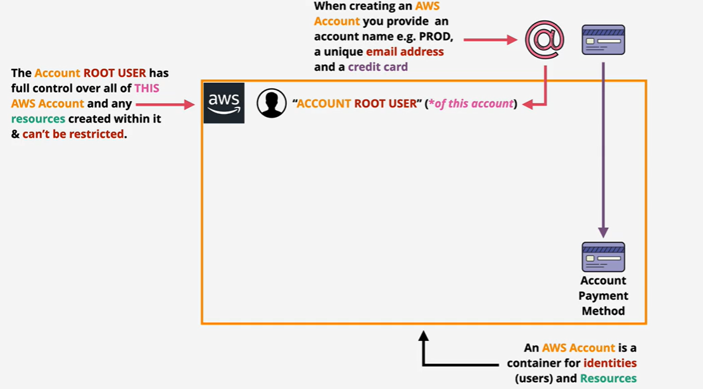

Slide 47
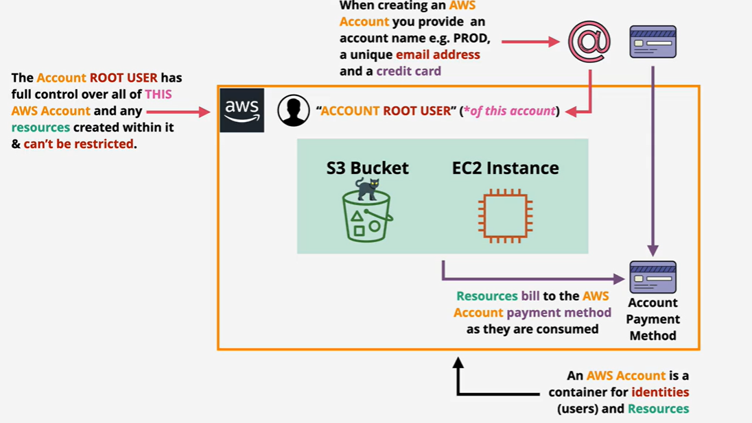

Slide 48
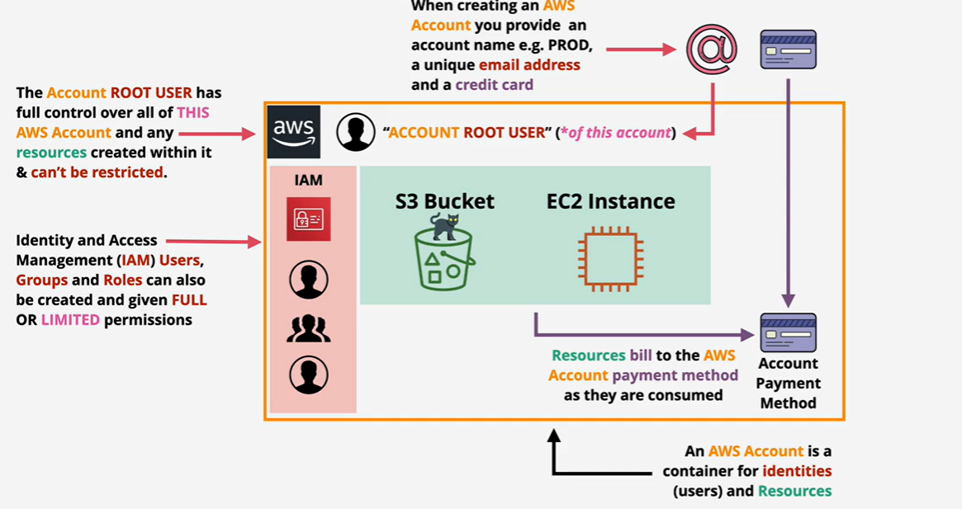

Slide 49
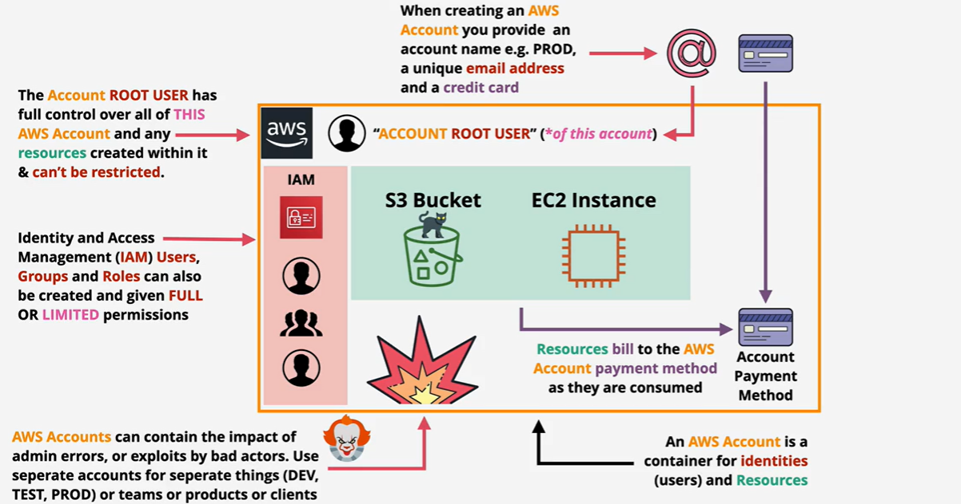

Slide 50
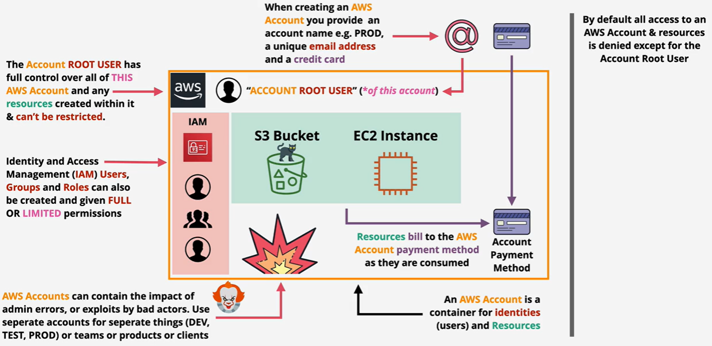

Slide 51
